Slide 1

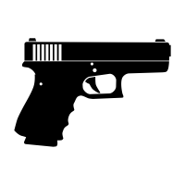
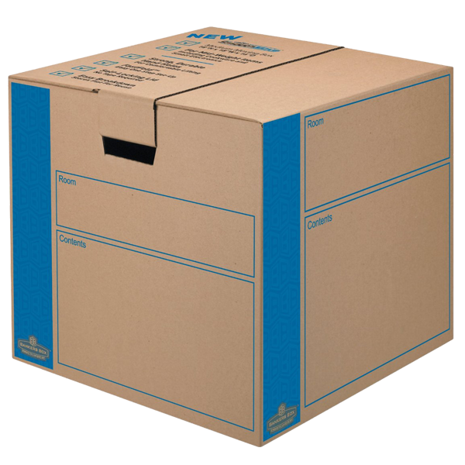
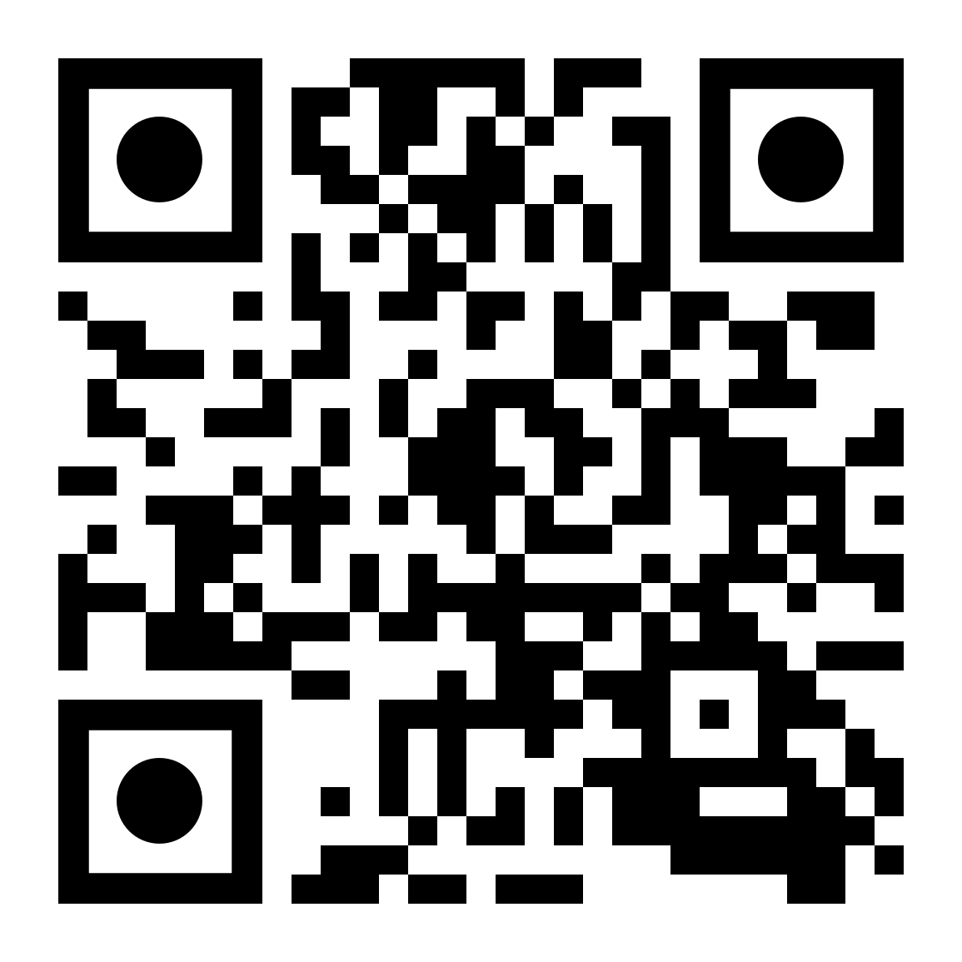
 | Renton Fish & Game Club Bay 6 Stage: Heavy Boxes Course Designer: Kris Erickson
"I've held an AR-15 in my hand…It is as heavy as ten boxes that you might be moving. And the bullet that is utilized; a .50 caliber, these kinds of bullets need to be licensed and do not need to be on the streets.” – Rep. Sheila Jackson Lee (D-TX). SCENARIO: While hauling the last heavy box of your AR-15 .50 caliber pistol clips to your gun room, you notice that your domicile is under attack. Get that box to your gun room, quickly assemble your fully licensed pistol, and repel the intruders.
START POSITION: Standing at start position, heels touching marks, holding box. All magazines to be used on the stage in box. Firearm on table, unloaded and pointed downrange |  | STRINGS: 1 SCORING: Unlimited SCORED HITS: Best 2 ROUND COUNT: 14 TARGETS: 7 IDPA, START-STOP: Audible - Last shot CONCEALMENT: Required Muzzle Safe Points: Muzzle safe markers / 180 degree rule SO NOTES:
STAGE PROCEDURE: At the start signal, retrieve your firearm. Engage available targets from cover positions. While moving from P1 to P2, you are surprised by T4&T5. NOTES:
T3
T2
T4
T5
T6
T7
T1
P2
P1
START
https://youtu.be/5CKOFGYkO0g?t=28

